Slide 1



Data Mining project
Volatility of the gold market
Notes:
to design and develop a machine learning model capable of accurately predicting the volatility of the gold market

Slide 2
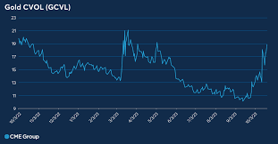
Business understanding
Project Objectives
Machine learning model
Volatility of the gold market
Background
Core problem
Accuratly forecast
Trading decisions
Success Criteria
Key performance indicators
Metrics used
Notes:
The primary objective of this project is to design and develop a machine learning model capable of accurately predicting the volatility of the gold market, using the Average True Range (ATR) as the key metric. Volatility, in this context, refers to the degree of variation in gold prices over time, which ATR effectively captures.
The core problem is to develop a machine learning model that can accurately forecast future gold market volatility. A high-performing predictive model could be used in the future to inform trading decisions, optimize risk management and improve returns on strategies that depend on price movement rather than direction.
Key performance indicators include prediction accuracy, with metrics such as Mean Absolute Error (MAE), Root Mean Squared Error (RMSE) and R² score used to evaluate the model.

Slide 3
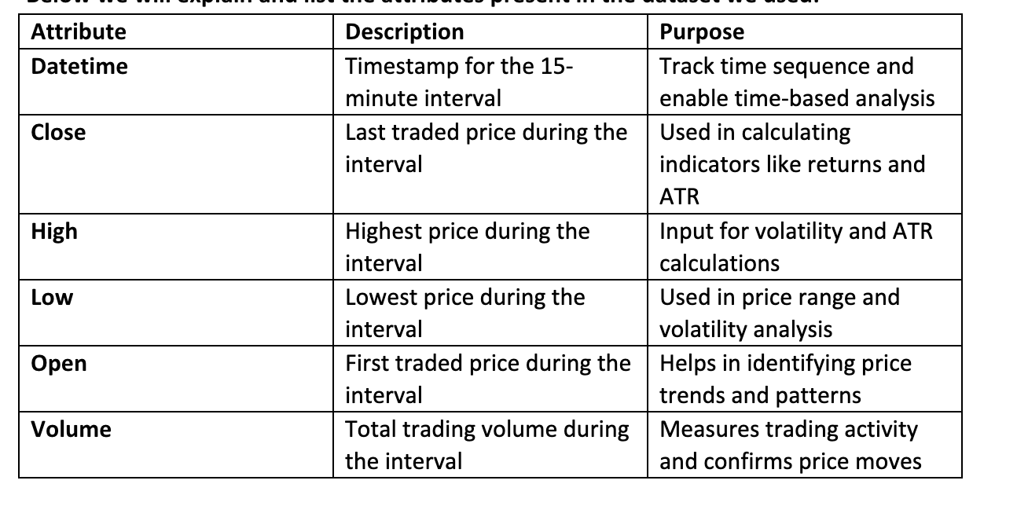
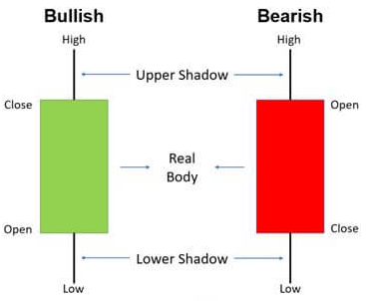
Data Understanding
Data Collection
15-Minute interval gold data
Recent data
Yahoo finance
Reliability
Data Description
Initial Exploration
candlestick charts
Notes:
For this project, we used 15-minute interval gold futures data, identified by the ticker symbol “GC=F,” which we retrieved from Yahoo Finance. The dataset spans the most recent 60-day period and includes standard market indicators such as open, high, low, close (OHLC) prices and trading volume. The data was downloaded in CSV format and imported into our environment for pre-processing and analysis.
Yahoo Finance is a widely used platform for accessing financial market data and is generally considered a reliable source for historical pricing information, particularly for research and modelling purposes.
This image shows how to read candlestick charts used in trading.
The green candle means the price went up during that time.
It opened low and closed high.
The red candle means the price went down.
It opened high and closed low.

Slide 4

Data Preparation
Data Cleaning
Two header rows
NaN Values
Data Intergration
Feature Engineering
ATR
RSI
Notes:
Only a few cleaning and transformation steps were applied to the dataset. First, the CSV file imported from the data source contained two header rows, creating a multi-index structure. To simplify the dataset, we removed the extra header row and retained a single-level header for easier access and processing. Additionally, any empty or missing fields in the dataset were identified and replaced with NaN values to standardize missing data handling.
Although we initially explored data integration, we ultimately decided against using it in the final model. Specifically, we attempted to combine 15-minute interval data with 60-minute interval data in a single CSV file, with the intention of enhancing the model’s predictive capability. However, during testing, we found that this merged dataset did not improve forecasting performance and introduced additional complexity. As a result, we chose to proceed solely with the 15-minute interval data, which proved to be more consistent and suitable for our modeling approach.
As part of our feature engineering process, we derived two important technical indicators from the original gold price data: the Average True Range (ATR) and the Relative Strength Index (RSI).
The Average True Range (ATR) is a widely used measure of market volatility. It captures the degree of price movement over a given period by considering the true range between high, low and closing prices (Hayes, 2024). In this project, ATR serves as the target variable for prediction, making it a central component of our modeling efforts.
The Relative Strength Index (RSI) is a momentum oscillator that measures the speed and change of price movements. It ranges from 0 to 100 and is commonly used to identify overbought or oversold market conditions (Fernando, 2024). By including RSI as a feature, we add contextual information about market momentum, which can help the model better understand underlying trends that may affect volatility.
We used these features because ATR directly aligns with our goal of predicting gold market volatility, while RSI provides additional insight into market behaviour that could influence volatility patterns. Together, these engineered features enhance the dataset’s informational depth and improve the model’s ability to make accurate forecasts.

Slide 5

Modeling
Model selection
RF
LTSM
Parameter Tuning
Training & Validation
Notes:
In this project, we explored multiple machine learning approaches to forecast gold market volatility. After reviewing different methods, we focused on two main models:
Random Forest (RF): A tree-based ensemble method known for its robustness and ability to model complex, non-linear relationships (Machine Learning | Google for Developers, n.d.). It was chosen for its simplicity and strong performance on structured data.
Long Short-Term Memory (LSTM): A type of recurrent neural network (RNN) specifically designed for time series data (Saxena, 2024). LSTM was selected because of its ability to capture patterns over time and handle sequential dependencies in financial data.
Our tuning strategy was exploratory and continual. Rather than using automated hyperparameter search techniques, we made adjustments step-by-step and observed their effect on validation performance using metrics such as Mean Absolute Error (MAE) and Mean Squared Error (MSE). This trial-and-error approach helped us identify an effective configuration for the LSTM model that ultimately outperformed our baseline models.
To prepare the data for model training and evaluation, we defined the target variable as the Average True Range (ATR) of the next time step. This means the model is trained to predict future volatility based on current and past market data.
For splitting the data, we used an 80/20 train-test split, carefully maintaining the chronological order of the time series. This means the first 80% of the data was used for training and the last 20% was reserved for testing. We did not shuffle the data, as preserving time order is essential in time series forecasting to ensure that the model is tested on future data, closely mimicking how it would be used in real-world applications.
As a baseline for comparison, we also implemented a naïve benchmark model, which simply predicts the next ATR value as being equal to the previous one. This helps us assess whether our more advanced models, like Random Forest and LSTM, offer meaningful improvements over a simple, rule-based prediction.

Slide 6

Evaluation
Performance Metrics
Model Interpretability
Comparison with Baseline
Notes:
Random Forest
The Random Forest model scored a MAE of 6.62 and a MSE of 136.45. It’s fast to train and relatively easy to interpret (e.g. using feature importance). However, it doesn’t capture time-based relationships, which can be important for time series data.
LSTM
The LSTM model performed better, with a MAE of 5.81 and a MSE of 106.03. It can learn patterns over time, which is useful for predicting a sequence like ATR. On the downside, it takes longer to train and is harder to interpret compared to tree-based models.
Ensemble Model
Combining the predictions from the Random Forest and LSTM resulted in a MAE of 6.20 and a MSE of 121.21. The performance was in between the two individual models. In this case, the ensemble didn’t outperform the best standalone model (LSTM).
Ensemble (LSTM + Random Forest average)
MAE: 6.20
MSE: 121.21
Averaging the predictions gave middle-ground results. It didn’t beat the standalone LSTM and added complexity.
Model Interpretability
• The Random Forest is easy to explain but lacks time awareness.
• The LSTM handles temporal patterns better but is less interpretable.
• The ensemble did not provide clear improvement over LSTM.
Comparison with Baseline
The naive benchmark used the previous ATR value as the prediction. Surprisingly, this simple method scored very well: MAE of 0.66 and MSE of 1.18.
The LSTM was the best performing of the trained models, but none of the advanced methods beat the naive benchmark. This suggests that the target variable (ATR) doesn’t change much over time, making it hard for complex models to add value. Using simple methods might be more effective here.

Slide 7

Deployment
Deployment strategy
Monitoring
Future work
Notes:
To deploy the model in a real-world setting, it would need to be integrated into a live system that can automatically process incoming market data and generate volatility predictions. This could be done by setting up a web API or a scheduled script that runs at regular intervals such as every 15 minutes to fetch the latest gold price data, pre-process it and feed it into the trained model. The model would then output the predicted Average True Range (ATR), which could be displayed in a dashboard or used as input for a larger trading or risk management system.
Once the model is deployed, it's important to monitor its performance regularly to ensure it continues to make accurate predictions. This involves comparing the model’s forecasts, such as predicted ATR values, with the actual values as they become available. Key metrics like Mean Absolute Error (MAE) and Root Mean Squared Error (RMSE) can be calculated in real time to track how well the model is performing. Setting up a simple dashboard can help visualize these metrics over time and alert systems can be put in place to notify the team if the model's accuracy drops unexpectedly.
To maintain and update the model, it should be retrained regularly using the latest data. This helps the model stay up to date with changing market conditions a process known as handling “model drift.” Automated workflows can be created to retrain and redeploy the model on a schedule, ensuring it's always using the most relevant information. Tools like version control and automated testing can help manage updates and make sure new versions perform better before they go live.
Project Summary: Rethinking ATR Prediction
Our initial approach predicted the absolute ATR value, but because ATR changes slowly, complex models like LSTMs often just repeat past values — similar to a naive model.
We’ve shifted to predicting ATR change instead:
Will ATR go up or down?
By how much?
This allows us to classify outcomes:
Class 0: ATR stays the same or decreases
Class 1: ATR increases
This simpler approach is still useful and easier to train.
Looking ahead, we plan to:
Explore unsupervised learning for volatility
Experiment with different feature sets
Though not ready for deployment, we’ve gained strong insights into both ML modeling and market behavior.

Slide 8
Conclusion
This project set out to build a reliable model for forecasting gold market volatility using ATR as the key metric. Our initial experiments showed that a simple naïve benchmark predicting the next ATR using the previous one performed surprisingly well, highlighting the persistent nature of market volatility.
We evaluated both Random Forest and basic LSTM models, but neither outperformed the benchmark. Ensemble attempts and incorporating Random Forest predictions as features also failed to deliver meaningful improvements.
This presentation shows our process from data cleaning and feature engineering to model selection and evaluation, providing a clear rationale behind each step.

